Slide 1

US HEALTH INSURANCE

Slide 2

Agenda
Data Finding
Feature Engineering
Model Trainings
Conclusion

Slide 3
Introduction
Goal:
Predicting charge risk of customers
Solution:
Obtaining and analyzing the dataset

Slide 4
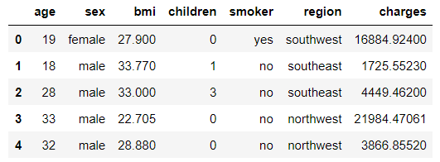
Data

Slide 5
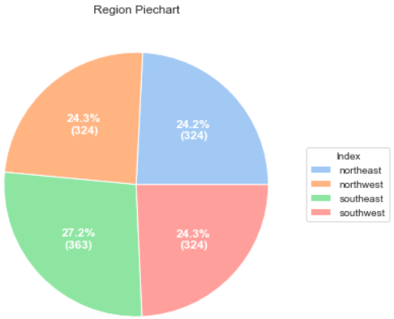
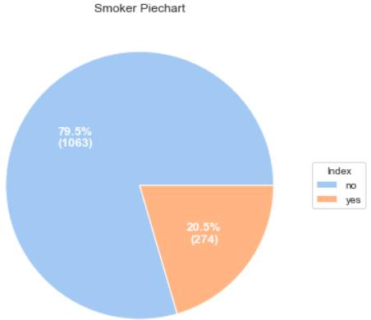
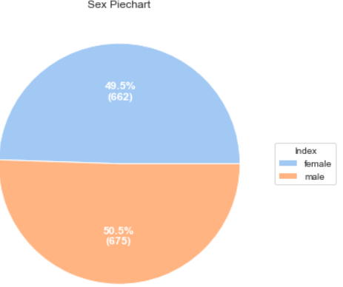
Data Exploration

Slide 6
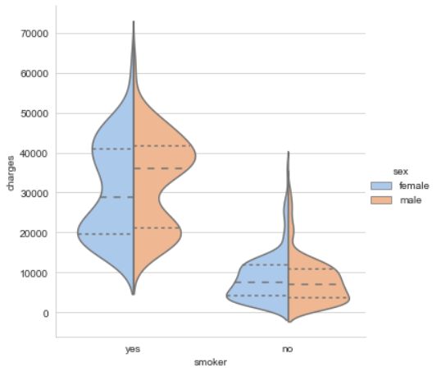
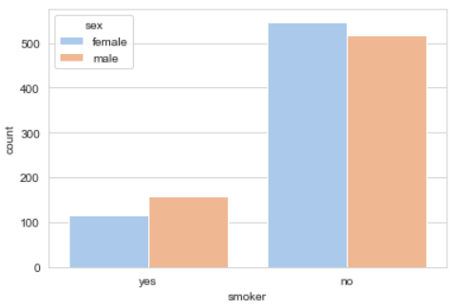
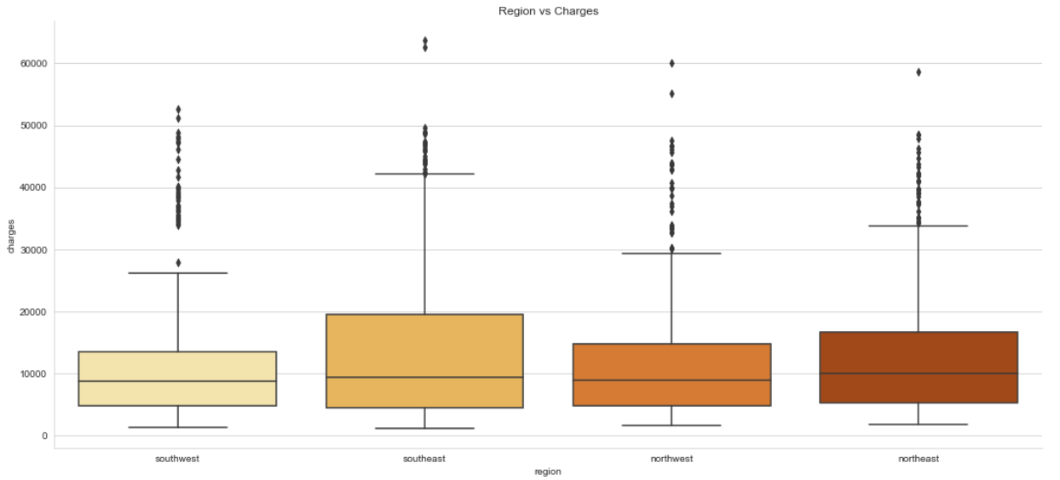
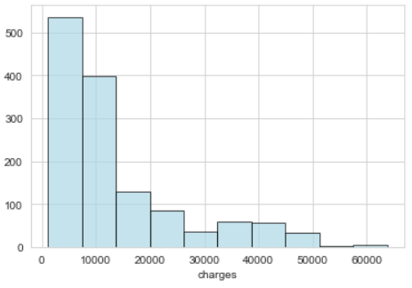
Data Exploration cont.

Slide 7
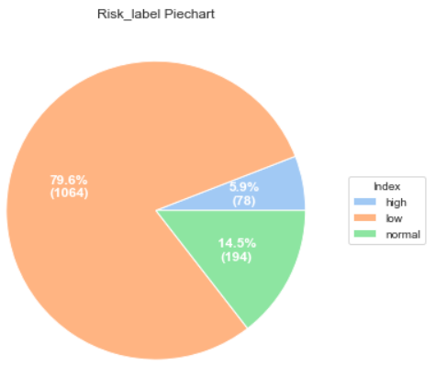
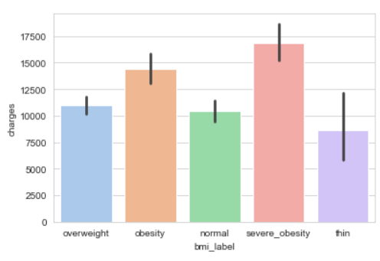
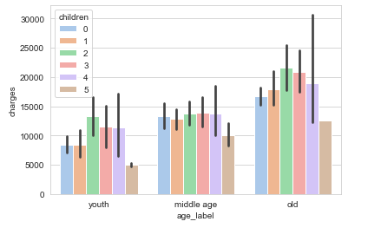
Feature Engineering

Slide 8
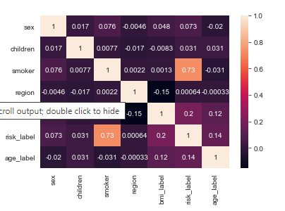
Correlation Heatmap

Slide 9
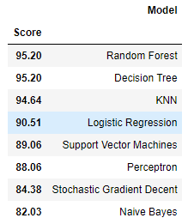
Model Achievements

Slide 10
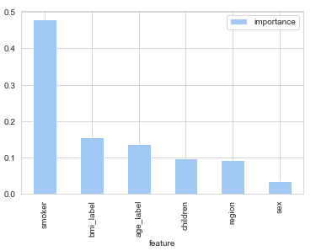
Feature Importance

Slide 11
Bizi dinlediğiniz için teşekkür ederiz.
Osman Güler
Harun Erbay

